Slide 1
Civil Rights Training
Commodity Senior Food Program
The Emergency Food Assistance Program
Arizona Department of Economic Security ● Division of Community Assistance and Development
Coordinated Hunger Relief Program
rev. 03/2024
Notes:
(Slide 1) Welcome to civil rights training
.

Slide 2
Annual Civil Rights Training for CSFP and TEFAP
Purpose
USDA Food and Nutrition Services (FNS) requires civil rights training for people involved in all administrative levels of programs that receive Federal financial assistance. It is also a requirement of the Coordinated Hunger Relief Program (CHRP). People who receive this training include staff and volunteers who regularly interact with program applicants and participants, and those who determine eligibility. Civil rights training must be completed each year.
Notes:
(Slide 2) USDA Food and Nutrition Services (FNS) requires civil rights training for people involved in all administrative levels of programs that receive Federal financial assistance. It is also a requirement of the Coordinated Hunger Relief Program (CHRP). People who receive this training include staff and volunteers who regularly interact with program applicants and participants, and those who determine eligibility. Civil rights training must be completed each year. Complete review of this presentation satisfies annual civil rights training requirements for the Commodity Senior Food Program and The Emergency Food Assistance Program.

Slide 3
Annual Civil Rights Training for CSFP and TEFAP
Course Topics
Civil Rights Legislation
Protected Bases
Assurances
Accessibility for Disabled Persons
Program Access for People with Limited English Proficiency
Effective Public Notification Systems
Customer Service and Its Role in Civil Rights Complaints
Complaint Filing and Handling
Compliance Monitoring
Additional Information and Resources
Notes:
(Slide 3) This course will introduce you to or refresh your knowledge of: modern civil rights legislation; protected bases identified in the legislation and the differences among CSFP and TEFAP compliance requirements; how to provide meaningful access to people who have limited proficiency with the English language; special rules for faith-based agencies; public notification systems; the provision of excellent customer service as a complaint countermeasure; how to handle complaints of discrimination; and additional information including some of the civil rights compliance resources available to you.

Slide 4
Annual Civil Rights Training for CSFP and TEFAP
Civil Rights Legislation
Civil Rights Act of 1964 Prohibits discrimination based on race, color, and national origin in programs and activities receiving Federal financial assistance.
Title IX of the Education Amendments of 1972
Prohibits discrimination based on sex under any education program or activity receiving Federal financial assistance.
Section 504 of the Rehabilitation Act of 1973
Prohibits discrimination based on disability.
Age Discrimination Act of 1975 Prohibits discrimination based on age in programs and activities receiving Federal financial assistance.
Notes:
(Slide 4) Congress began acting regarding civil rights with the Civil Rights Act of 1866. Between 1866 and 1964, an extraordinary amount of activity and advocacy took place. A full study of this time period would take far longer than the time we have, so we’ll move up a bit and start with the Civil Rights Act of 1964. This law established the prohibition against discrimination based on race, color, or national origin in programs and activities receiving Federal funding. Title IX of the Education amendments of 1972 prohibited discrimination based on sex, Section 504 of the Rehabilitation Act of 1973 prohibited discrimination based on a person’s disability, and the Age Discrimination Act of 1975 prohibited discrimination based on a person’s age.

Slide 5
Annual Civil Rights Training for CSFP and TEFAP
Civil Rights Legislation
The Civil Rights Restoration Act of 1987
Clarifies the scope of Title VI of the Civil Rights Act of 1964 and related laws to ensure nondiscrimination in all programs and activities, regardless of individual program funding sources.
The Americans with Disabilities Act of 1990
Prohibits discrimination based on disability in all services, programs, and activities provided to the public by State and local governments, except for public transportation services.
Notes:
(Slide 5) The Civil Rights Restoration Act of 1987 served to clarify and strengthen civil rights regulations, and the Americans with Disabilities Act specifically prohibited discrimination based on a person’s disability in all State and local programs, except for public transportation services

Slide 6
Annual Civil Rights Training for CSFP and TEFAP
Bases and Protected Bases
Base
A characteristic of a person, such as the person’s race, religion, or national origin
Class
Individuals who share a common base
Protected Base
A specific, identified characteristic on which the level of service provided
to the person must not be considered
Protected Class
Individuals who share a common protected base
Notes:
(Slide 6) The terms “protected base” and “protected class” are used interchangeably during conversations about civil rights, but there is a difference between a “base” and a “class”. A “base” is an actual trait or characteristic a person has. For example, the base “driver” could apply to a person who drives their car to work. Another base, “bicyclist”, can refer to people who ride their bicycle to work. A “class” is made up of all the people who share a certain base characteristic. So, people who drive to work belong to the class “drivers”. Likewise, a bicyclist belongs to the class “bicyclists”. A “protected base” is like any other base, except that it has been specifically identified in civil rights legislation as being a characteristic on which discriminatory actions must never be based. A “protected class” is made up of those who have the protected base characteristic in common. Protected bases are not broken down into further identifiers. The base “age” applies to all ages, “color” applies to all colors, race applies to all races, and so on.

Slide 7
Annual Civil Rights Training for CSFP and TEFAP
Protected Bases
CSFP and TEFAP Protected Bases
Race
Color
National Origin
Sex
Disability
Age
Notes:
(Slide 7) The protected bases are race, color, national origin, sex (including gender identity and sexual orientation), disability, and age.

Slide 8
Annual Civil Rights Training for CSFP and TEFAP
Assurances
To qualify for Federal financial assistance, an application must be accompanied by a written assurance that the entity to receive financial assistance will be operated in compliance with all nondiscrimination laws, regulations, instructions, policies, and guidelines.
Regional Food Bank and Agency Agreements
Form HRP-1040 “Annual USDA Commodity Food Service Application and Agreement between Regional Food Bank and Distribution Site” is completed annually by all Regional Food Bank TEFAP and CSFP recipient agencies.
Notes:
(Slide 8) A requirement of any recipient receiving Federal financial assistance is that they must agree to several assurances including those involving Civil Rights. Each year, Regional Food Banks have their TEFAP and CSFP recipient agencies sign form HRP-1040. Similar agreements are made between FNS and DES and DES and Regional Food Banks.

Slide 9
Annual Civil Rights Training for CSFP and TEFAP
Accessibility for Disabled Persons
Regional Food Banks and their TEFAP and CSFP recipient agencies are required to provide reasonable accommodations for clients who are disabled or have limited mobility.
This can be accomplished by
Ensuring intake/distribution sites have ramps and/or elevators.
Promoting the use of proxies
Providing various forms of distribution in addition to “walk-up” including drive-thru and home delivery models (where available)
Notes:
(Slide 9) Regional Food Banks and their TEFAP and CSFP recipient agencies are required to provide reasonable accommodations for clients who are disabled or have limited mobility. This includes ramp and elevator access, encouraging the usage of proxies, and providing alternate methods of distribution including drive-thru and home delivery (where available).

Slide 10
Annual Civil Rights Training for CSFP and TEFAP
Program Access for People with Limited English Proficiency
Limited English Proficiency (LEP) Persons
An LEP person does not speak English as their primary language and has a limited ability to speak, write, read, or understand English.
LEP persons must be provided the same opportunities to access program services and activities.
The failure to provide potentially eligible LEP persons with access to Federally-assisted programs may be considered discrimination based on national origin.
Agencies must take reasonable steps to assure meaningful access to the information and services they provide.
Notes:
(Slide 10) So now, let’s consider people who need help but are not fluent or proficient in English. We refer to these participants and prospective participants as having Limited English Proficiency or “LEP”. The objective of LEP policy is to overcome communication barriers and to provide LEP clients with the same opportunity to participate in our programs as English-proficient participants have. When an agency fails to provide reasonable language assistance, the agency may be seen as discriminating on the basis on national origin. So, it’s vital that Food Banks and agencies take reasonable steps to assure meaningful access to services for all clients, regardless of English-language skills.

Slide 11
Annual Civil Rights Training for CSFP and TEFAP
Program Access for People with Limited English Proficiency
Determining Reasonable Steps to Meaningful Access
The reasonable steps an agency takes to assure meaningful access are dependent on a number of factors.
The number or proportion of LEP persons eligible to be served or likely to be encountered within the area serviced by the recipient;
Frequency with which LEP individuals come in contact with the program;
Nature and importance of the program, activity, or service provided by the program;
Resources available and their costs.
Notes:
(Slide 11) To determine what the reasonable steps to assure meaningful program access are for your agency, look back on the language use of participants you’ve helped in the past and the frequency with which you have contact with LEP persons. Then, use the historical data to help plan for your LEP needs. Keep in mind that the greater the number or proportion of LEP persons your agency serves and the more frequent your contact with LEP participants is, the more likely language services will be needed. We also want to consider how important the program is to people’s lives. People cannot survive very long without food, and people who have access only to non nutritive foods cannot perform to their maximum potential at school, at home, or on-the-job. So, CSFP and TEFAP activities and services are considered critical programs. Finally, evaluate your agency’s resources to determine if coming into compliance with LEP requirements or aspects of providing language assistance services would create an unreasonable strain on the agency. When looking at resources, take everything into account. Dollars and equipment are obvious resources, but the number of people you have on staff and their individual language skills could also make an impact your determination.

Slide 12
Annual Civil Rights Training for CSFP and TEFAP
Program Access for People with Limited English Proficiency
Determining Reasonable “Ask Yourself” Steps to Meaningful Access
Evaluate the agency’s compliance obligation and capacity by considering past activity, current resources, and workload projections.
Notes:
(Slide 12) To assess your frequency of contact with LEP persons, use the same technique as before. Examine historical data, community information, and agency projections. Also, consider any outreach initiatives in communities with a high proportion of LEP persons. A new outreach campaign may increase the likelihood of language assistance services being needed.

Slide 13
Annual Civil Rights Training for CSFP and TEFAP
Program Access for People with Limited English Proficiency
STEP 2:
What have we experienced when providing LEP services?
What does the census data say about language usage in our local area?
Are there any school district, State, or local statistics to consult?
What have other agencies in the area determined about the community’s language proficiency, usage and needs?
STEP 1:
How often does the agency provide services to LEP persons?
What percentage of our clients are LEP persons?
What languages have we encountered in the past?
Will outreach initiatives increase our contacts with LEP persons?
Notes:
(Slide 13) You can use specific questions to begin your agency self-assessment. When you need a certain piece of information, use available resources to save time and make the determination easier. By tracking language usage, agency records will contain information that allows you to establish baseline numbers. To help with learning more details about your local area, the U.S. Census Bureau, school districts, and other agencies can be valuable resources. One helpful resource to highlight when searching for information about Arizona communities is the Census Bureau’s American FactFinder. It can be accessed online at https://data.census.gov/cedsci/

Slide 14
Annual Civil Rights Training for CSFP and TEFAP
Program Access for People with Limited English Proficiency
STEP 3:
How important are our programs, services, or activities to people’s lives?
Would denying or delaying program access present serious or life-threatening implications?
Does the program include compulsory activities, such as particular education programs or information distribution requirements, that can be seen as evidence of the program’s importance?
STEP 4:
What is our level of resources?
Are there other agencies or groups we can contact to pool or share LEP materials or development costs?
Do we have bilingual staff or volunteers we can train to act as interpreters and translators?
At what point does the resource expenditure become unreasonable when compared the benefits gained?
Can we substantiate a claim of insufficient resources when limiting language assistance services?
Notes:
(Slide 14) The next question to ask yourself is how important the program is to people’s lives. We know that nutrition programs are critical. Everyone, regardless of wealth, status, or background, needs to eat. We also know that delaying or denying a participant’s access to commodities or services could very well lead to serious or life-threatening situations for the client. Another way to judge a program’s importance is to look at any compulsory client activities that are part of the program. An example of this would be the requirement to provide nutrition education to CSFP participants.
If you’ve determined that there is a need for a higher level of language assistance services but found that the resources you would need to expend to provide the services could cause damage to the agency’s health, explore other options like resource sharing. Collaborating with other agencies when developing language assistance materials can save time and money for all agencies involved. If the agency doesn’t have enough resources to develop LEP material and you cannot locate a collaboration opportunity, you must be able to substantiate the claim of insufficient resources when there is a potential services could be limited. Be sure to work with your HRP program specialist to discuss the agency’s resource and collaboration barriers. The HRP may have access to resources that can help prevent unnecessary limitations when providing critical services to LEP clients.

Slide 15
Annual Civil Rights Training for CSFP and TEFAP
Effective Public Notification Systems
All USDA FNS assistance programs must include a public notification system.
Public notification systems are critical channels of communication. These systems involve three basic elements.
Program Availability – details program rights and responsibilities and steps necessary for participation.
Complaint Information – advises people of their right to file a civil rights complaint, how to file a complaint, and the complaint procedures.
Nondiscrimination Statement – clearly lists protected bases and informs on nondiscrimination policy.
Department of Economic Security ● Coordinated Hunger Relief Program ● Federal Fiscal Year 2021 [ ‹#› ]
Notes:
(Slide 15) In order to advise clients of their rights when participating in assistance programs, agencies need to employ an effective public notification system that has information about program availability, understand how to file a complaint of discrimination, and prominently display the USDA FNS nondiscrimination statement.

Slide 16
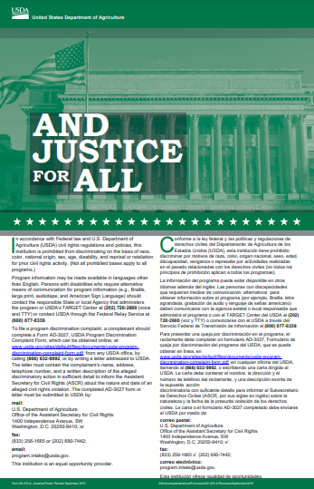
Annual Civil Rights Training for CSFP and TEFAP
Effective Public Notification Systems
All USDA FNS assistance programs must include a public notification system.
Prominently display the appropriate AD-475A “And Justice for All” poster.
Posters must be displayed in their original size of 11” x 17”
Full Color or Grayscale
Notes:
(Slide 16) “And Justice for All” posters help bolster your notification system by clearly presenting the client with Federal nondiscrimination policy. “And Justice for All” posters must be prominently displayed in the original size of 11-inches wide by 17-inches tall. Full color or grayscale displays are allowable. However, the preference is for full size posters in color, procured by State Agency or FNS. The green AD-475A poster is for use by CSFP and TEFAP agencies. Remember, the poster needs to be seen where the service is being provided.

Slide 17
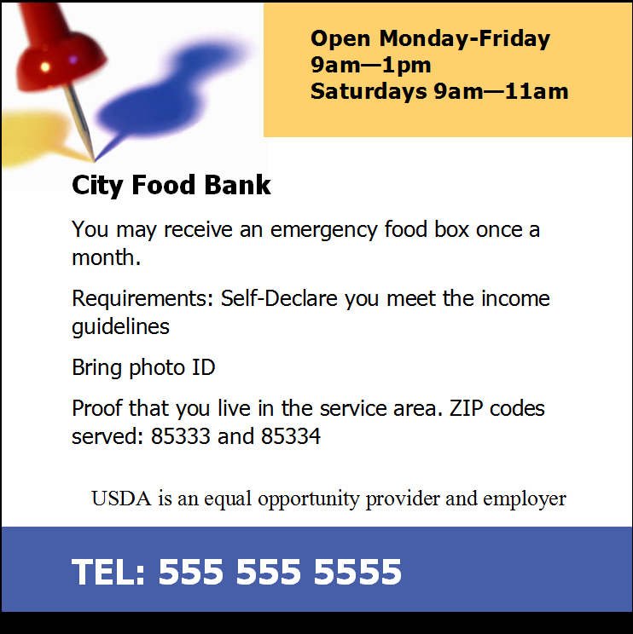
Annual Civil Rights Training for CSFP and TEFAP
Effective Public Notification Systems
All USDA FNS assistance programs must include a public notification system.
Inform on available programs and steps necessary to participate.
Notes:
(Slide 17) Program availability notification will include on its materials the hours the distribution site is open, the phone number, program eligibility and participation information, and the nondiscrimination statement.

Slide 18
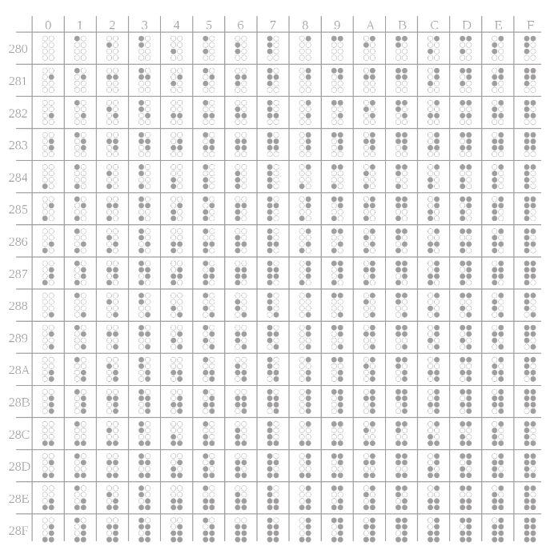
Annual Civil Rights Training for CSFP and TEFAP
Effective Public Notification Systems
All USDA FNS assistance programs must include a public notification system.
Provide information, including information on websites, in alternative formats for people with disabilities.
Audio Descriptions
Large Print Transcriptions
Braille
Notes:
(Slide 18) Notification systems and other important information need to be delivered in a way that allows clients and prospective clients to receive the information. Sometimes, common ways of presenting information can cause difficulty for people with certain disabilities. For example, a person with a total loss of vision may need written information provided in an audio format or in Braille. A person with a partial loss of vision may not need audio or Braille and may be comfortable seeing the same information in a large-print format. Different disabilities require different accommodations. Be sure to work with the client to provide the most effective, reasonable accommodation that will allow the client the same opportunity to participate in programs as those who do not have disabilities.

Slide 19
Annual Civil Rights Training for CSFP and TEFAP
Effective Public Notification Systems
All USDA FNS assistance programs must include a public notification system.
Include the required nondiscrimination statement on all appropriate agency publications, websites, posters, and other materials meant for the public.
Websites must include the full statement, or a direct hyperlink to the statement, on the program information home page.
Use the full standard statement on large items like pamphlets, brochures, and other multi-page materials.
Use the short statement on smaller items like flyers, door hangers, and appointment or post cards.
You do not need to include a nondiscrimination statement on reinforcement items, such as pens, note pads, or fabric grocery bags.
Notes:
(Slide 19) The USDA FNS nondiscrimination statement informs people of a program’s legally protected bases and provides USDA contact details so people can get a version of the statement in an alternate format or file a complaint of discrimination directly with the USDA. All materials and sources used to inform the public about USDA FNS programs must contain the nondiscrimination statement. For websites, you have the option of placing the statement on the program information home page or linking to it. If you do put the statement on your website, it does not need to go on every page—just on the program home page. The full, authorized nondiscrimination statement is about one-thousand, six-hundred characters. When drafting larger materials like pamphlets, brochures, or booklets, use the full, authorized nondiscrimination statement. Sometimes, a smaller item is used to promote services. Materials like one-sheet flyers, door hangers, and appointment or post cards don’t have the space for the full statement. When drafting these smaller items, USDA allows the use of the short nondiscrimination statement. Small giveaway materials you might use when tabling or canvassing, like pens, note pads, and grocery bags, are called “reinforcements”. These items are not required to have a full or short nondiscrimination statement.

Slide 20
Annual Civil Rights Training for CSFP and TEFAP
Customer Service and Its Role in Civil Rights Complaints
Good customer service can help agencies avoid complaints.
The USDA has found that many civil rights complaints are actually customer service issues.
A perception of rudeness, impatience, or a lack of understanding or compassion can be interpreted in a number of ways.
Notes:
(Slide 20) The USDA has found that many civil rights complaints aren’t caused by agency discrimination based on a protected base but are instead related to a person’s perception of the customer service they receive. When people receive poor customer service, they may believe the root cause of the behavior is discriminatory and file a complaint. They may be right, but they could also be wrong. Either way, the person carries the perception that they have been subject to discrimination in a Federally assisted program, and that perception provides reasonable cause to file the complaint and start an investigation. Also, a person who feels uncomfortable visiting an agency for service due to past perceptions of discrimination may choose to go to elsewhere for services. The person may also believe that they will receive the same treatment at other locations and choose to stop seeking assistance altogether. Avoid having poor customer service as the cause of a civil rights complaint by coaching staff and volunteers on some of the ways we can provide excellent customer service without incurring additional costs or causing inefficiencies. We want clients to be informed and feel appreciated, so simple things like listening to client concerns, explaining program rules, and asking for feedback on our performance go a very long way.

Slide 21
Annual Civil Rights Training for CSFP and TEFAP
Complaint Filing and Handling
Any person has the right to file a complaint of discrimination.
Complaints must be filed within 180 days of the alleged discriminatory action.
Complaints can be written or verbal.
All complaints must be accepted.
All complaints citing Federal bases will be referred to FNS.
Anonymous complaints are handled the same as other complaints.
Agencies cannot require a complaint to be submitted on a special form.
Complainants and agencies are encouraged to resolve the complaint at the lowest level and as expeditiously as possible.
Notes:
(Slide 21) It does not need to be a client or prospective client who files a complaint of discrimination against your agency. Anyone has the right to file a complaint of discrimination. For example, a person who is not in need of agency services and is simply passing by your building could see something that leads the person to believe that what they saw was a discriminatory practice. That person has the same right to file a complaint as that of a program participant. Written complaints can be submitted in a number of ways. The HRP has developed standardized forms that are recommended for use, but clients must not be required to use an HRP form or any specific form at all. For example, a complaint written on the back of a flyer or printed on sheet of copy paper are as legitimate as those written on an HRP form and must be accepted. People may choose to complain verbally, too. When receiving a verbal complaint, agencies are obligated to offer assistance. Use the appropriate HRP form to capture relevant information, submit the complaint, and document related events. People also have the right to file a claim anonymously. When this happens, advise the person that the complaint will be handled with the same urgency as other complaints, but the USDA, HRP and your agency will not be able to reach out to inform the person of complaint findings or to gather additional information.

Slide 22
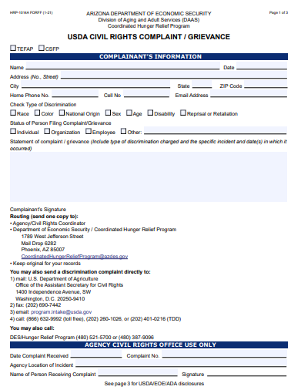
Annual Civil Rights Training for CSFP and TEFAP
Complaint Filing and Handling
People can choose to register a complaint with the agency, USDA, or DES.
Keep HRP-1014A and HRP-1014A-S USDA Civil Rights Complaint/Grievance forms available and ready to give to people at their request. Train staff and volunteers on how to use the form.
Notes:
(Slide 22) Form HRP-1014A is used for complaints against agencies. When the complaint involves multiple programs, or the involved program is not readily identifiable, you can use either form. The primary concern is to capture the information needed to begin the investigation. Individuals always have the right to file directly with FNS.

Slide 23
Annual Civil Rights Training for CSFP and TEFAP
Complaint Filing and Handling
Verbal complaints require agency assistance.
When receiving a verbal complaint, agency staff or volunteers become obligated to complete the complaint form. Every effort should be made to complete the form with as much information as possible.
Complainant contact information
The name and location of the agency receiving the complaint
The nature of the incident or action that let to the complaint
The basis on which the complainant believes discrimination exists
Witness contact information
The date the action or actions occurred
If the action or actions are ongoing, the date they began.
Notes:
(Slide 23) Remember to treat verbal complaints received over the phone the same as those received in person. For all complaints, vital information to document includes:
1. The complainant’s contact information, when the person does not want to remain anonymous;
2. The receiving agency’s contact information;
3. A description of the event or events leading to the complaint;
4. On what base or bases the person believes discrimination occurred;
5. The contact information of any witnesses, including agency staff or volunteers; we can ask clients and prospective clients to give us these details but cannot demand them. We must never limit or deny access to services based on a witness’ choice not to be involved with the complaint.
6. The date the alleged discriminatory behavior occurred; and
7. If the behavior is ongoing, the date the behavior started.

Slide 24
Annual Civil Rights Training for CSFP and TEFAP
Complaint Filing and Handling
All complaints alleging discrimination must be processed within 90 days.
Complaints are sent to the Food Bank who sends them to DES
Place a copy of the complaint in the civil rights complaint log, and document all actions and conversations related to the complaint.
Agencies may create their own log formats and storage methods. Binders, folders, and electronic storage are acceptable.
Agency
Food Bank
DES
Notes:
(Slide 24) Complaints of discrimination are processed within 90 days. If you are a local commodity distribution agency, like a food pantry or congregate meal site, immediately forward a copy of the complaint to your regional food bank. The regional food bank will begin working with the HRP to process the complaint and send it forward to HRP. Each agency must maintain a civil rights complaint log. Use the log as a place to put copies of complaint forms and to document any actions or conversations related to the complaints. The format of the log is up to the agency but must capture elements in the 2016 Memorandum of Understanding (MOU) between DES and USDA. Binders, folders, and similar items are acceptable. Be sure that the complaint log’s location is known to staff and include its purpose in your internal agency trainings. *For more information, contact RFB.

Slide 25
Annual Civil Rights Training for CSFP and TEFAP
Compliance
Compliance Reviews
DES HRP is responsible for reviewing the CR compliance of CSFP and TEFAP regional food banks.
CSFP and TEFAP regional food banks are responsible for reviewing the CR compliance of local distribution sites.
USDA or DES HRP may, at any time, perform a CR compliance review of any agency under their respective authority.
The office performing the review must advise the reviewed agency, in writing, of review findings and recommendations.
Agencies must be in compliance with CR requirements to be eligible for Federal financial assistance.
Notes:
(Slide 25) Compliance reviews provide the opportunity to identify and correct deficiencies. The regional food banks are responsible for reviewing the compliance of sites under their authority. A USDA or HRP compliance review can happen at any time. When an agency has been selected, the office performing the review must provide it with a written report of findings along with recommendations to correct deficiencies. Agencies that fall out of compliance run the risk of having their CSFP and/or TEFAP partnership terminated.

Slide 26
Annual Civil Rights Training for CSFP and TEFAP
Compliance
Resolving Noncompliance
Immediately after noncompliance is determined, agencies receive written notification and recommendations for corrective action.
DES HRP attempts to achieve voluntary compliance.
Agencies have 60 days to complete corrective action.
When agencies do not comply with the corrective action voluntarily, DES HRP engages with the USDA Office of Civil Rights for further action.
Failure to comply with CR requirements may lead to the loss of Federal funding or other penalties as provided by 7 C.F.R. Part 15.
Notes:
(Slide 26) When an agency is found to be out of compliance, it will receive a written notification of the reasons, or “findings”, causing the determination of noncompliance as well as recommendations on corrective actions. The HRP works with noncompliant agencies and tries to achieve voluntary compliance. Agencies are allowed 60 days to implement corrective actions. When the agency is not able to correct noncompliance in 60 days, the HRP will elevate the facts of the issue to USDA FNS for further review and action.

Slide 27
Annual Civil Rights Training for CSFP and TEFAP
Additional Information and Resources
Training
All HRP programs have the same civil rights training requirements.
Must be taken every year
Mandatory for frontline staff and volunteers
Mandatory for the supervisors of frontline staff and volunteers
Mandatory for Program administrators and encouraged for agency leadership
Paid frontline staff and supervisors must take the full training course.
Specific topics must be covered.
DES HRP trains local agency specialists; local agency specialists train their respective agency personnel.
Notes:
(Slide 27) Civil rights training requirements for all HRP programs are the same. Training must be taken every year and is mandatory for frontline staff and volunteers. New employees and volunteers should take the training before beginning frontline service. The term “frontline” means those who work directly with the public. Training is also mandatory for the supervisors of frontline staff and volunteers. Program administrators and agency leadership who are not responsible for the direct supervision of frontline personnel are encouraged to take annual training, as it will provide people in these positions with knowledge that can help avoid compliance issue while increasing client satisfaction. Training must cover specific civil rights topics, as listed in FNS Instruction 113-1. It is allowable for the HRP to provide training to one person from the agency. The person can then deliver training to the remaining agency personnel and new-hires.

Slide 28
Annual Civil Rights Training for CSFP and TEFAP
Additional Information and Resources
Data Collection and Reporting
Used to determine how effectively FNS programs are reaching potential eligible persons and beneficiaries, and to identify areas where additional outreach is needed.
Client self-identification of race and ethnicity is preferred.
Agency identification of client race and ethnicity is acceptable when clients decline to provide a response.
Collected by DES when completing an online application or when a paper application is submitted to a local eligibility office
Two ethnicity categories – clients pick one option
Five or more race categories – clients pick as many options as necessary
The collection of this data is required for CSFP participants but optional for TEFAP participants.
Notes:
(Slide 28) When people come to us for service, we need to make sure we’re collecting information about the person’s race and ethnicity. In general, applications for nutrition program benefits will contain a section dedicated to this data. Clients may become concerned or offended when asked about their race and ethnicity. For clients who are open to explanation, tell them the importance of why we collect the data and provide assurance that race and ethnicity are never used as eligibility criteria for our programs. Race and ethnicity information is collected and used to enhance, or improve, programs and as a measure of agency civil rights compliance. Some clients may not be open to explanation. While the client’s self-identification of their race and ethnicity is preferred, agencies are authorized to select race and ethnicity options based on observation of the client. Two ethnicity descriptors, Hispanic or Latino and Not Hispanic or Latino are available. Only one ethnicity selection can be made. Five race options exist: American Indian or Alaska Native; Asian; Black or African American; White; and Native Hawaiian or Other Pacific Islander. The number of selections for race is not limited.
The collection of this data is required for CSFP participants but optional for TEFAP participants.

Slide 29
Annual Civil Rights Training for CSFP and TEFAP
Additional Information and Resources
Data Collection and Reporting
Clients must never be required to furnish information about their races or ethnicities as a condition of eligibility. When clients decline to provide the information, agencies must provide the information on the client’s behalf. Observe the client and determine, to the extent practicable, the client’s race and ethnicity. When the client provides the information, agencies must not alter the provided data.
Notes:
(Slide 29). The USDA requires that participant ethnicities and races be collected for the CSFP program, however they must never be required to furnish information about their races or ethnicities as a condition of eligibility. When clients decline to provide the information, agencies must provide the information on the client’s behalf. Observe the client and determine, to the extent practicable, the client’s race and ethnicity. When the client provides the information, agencies must not alter the provided data.
Must advise client of voluntary data collection and what it is used for/not used for. If the information is not volunteered, agency must notify how agency will document the information.

Slide 30
Annual Civil Rights Training for CSFP and TEFAP
Additional Information and Resources
Full nondiscrimination statement
The full English and Spanish nondiscrimination statements in PDF are available for download on the USDA FNS website.
https://www.fns.usda.gov/cr/fns-nondiscrimination-statement
Reinforcements do not need to include a nondiscrimination statement.
Notes:
(Slide 30) The full USDA FNS nondiscrimination statement can be found on the USDA website at https://www.fns.usda.gov/fns-nondiscrimination-statement. English and Spanish versions are available as PDF downloads.

Slide 31
Annual Civil Rights Training for CSFP and TEFAP
Additional Information and Resources
Short nondiscrimination statement
The short nondiscrimination statement may be used on material that is too small to permit the full statement to be included. The statement must be in a print size no smaller than the text of the material.
This institution is an equal opportunity provider.
Notes:
(Slide 31) The short nondiscrimination statement is used for smaller materials. In its entirety, the short statement is, “This institution is an equal opportunity provider.” When using the short statement, be sure the size of the text is no smaller than the text in the body of the piece. Remember, reinforcement items do not need to carry a nondiscrimination statement.

Slide 32
Annual Civil Rights Training for CSFP and TEFAP
Additional Information and Resources
FNS 113-1 Civil Rights Compliance and Enforcement – Nutrition Programs and Activities
Establishes and conveys policy and provides guidance and direction to the United States Department of Agriculture Food and Nutrition Service and its recipients and customers and ensure compliance with and enforcement of the prohibition against discrimination in all FNS nutrition programs and activities, whether federally funded in whole or not.
https://www.fns.usda.gov/civil-rights-compliance-and-enforcement-%E2%80%93-nutrition-programs-and-activities
Notes:
(Slide 32) FNS Instruction 113-1 is a critical civil rights compliance document. It outlines the information we’re covering today, as well as potential enforcement actions that can occur when agencies do not comply with civil rights requirements. FNS 113-1 is suggested reading for all agency staff and volunteers, especially those in a civil rights coordination role. It can be found on the USDA website at https://www.fns.usda.gov/civil‑rights‑compliance‑and‑enforcement‑%E2%80%93‑nutrition‑programs‑and‑activities.

Slide 33
Annual Civil Rights Training for CSFP and TEFAP
Additional Information and Resources
State Agency Contact Information
Arizona Department of Economic Security
Division of Community Assistance and Development
Coordinated Hunger Relief Program
1789 West Jefferson Street, MD 6282
Phoenix, Arizona 85007
CoordinatedHungerReliefProgram@azdes.gov
https://des.az.gov/services/basic-needs/food-assistance
Notes:
(Slide 33) Thank you for participating in the civil rights training. We encourage you to reach out whenever you need guidance on civil rights compliance.
Arizona Department of Economic Security
Division of Community Assistance and Development
Coordinated Hunger Relief Program
1789 West Jefferson Street, MD 6282
Phoenix, Arizona 85007
CoordinatedHungerReliefProgram@azdes.gov
https://des.az.gov/services/basic-needs/food-assistance

